Slide 1


Slide 2
Hello again, Human! I hope have you liked your journey until here. Now, you know what is IoT, but where it is in our day by day? Can you think if you have any IoT device at home? I am sure you will have at least one ☺
I am going to show you 4 examples of IoTs and how they work in a high level ☺

Slide 3
Have you ever thought your smart watch is an IoT device?
Fitbit
Fitbit –Smart device with sensor
Fitbit is an worldwide well know IoT wearable which track day by day activities.
Fitbit is a smart device with sensor embedded. It can collect and compute data extracted by itself.
Fitbit app in smartphone has a dashboard to track activity, record workouts, log food, connect with friends and family & more.
Bluetooth
Smartphone – device

Slide 4

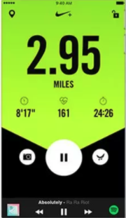
Have you ever thought how runners are tracked? Is it only about crossing the Finish line? No! They measure a lot more: pace, distance, route, etc. How the measure it? Have a look in this example!
Nike+
Nike+ tracks the performance of runners through a wireless connection.
Components: the Nike+ sensor, a pair of shoes compatible with Nike+ and a tracking device.
Nike+ sensor is not a smart device, it is only a sensor. It can collect data, but it can not be compute the data extracted by itself, which means it is needed a device to manage the data.
Smartphone – device
Wireless
Nike+ - Sensor

Slide 5
I will seat a bit, so many examples to tell you! I got tired ☺
Alexa
Do you know my girlfriend Alexa? She is so smart! She can help you to automatize your home! I am so in love with her!
Amazon Alexa is a virtual assistant technology developed by Amazon
It is capable of voice interaction, music playback, making to-do lists, setting alarms, streaming podcasts, playing audiobooks, and providing weather, traffic, sports, and other real-time information, such as news.
Smart devices with sensors
Alexa control smart devices using itself as a home automation system. Users are able to extend the Alexa capabilities by installing "skills" (additional functionality developed by third-party vendors, in other settings more commonly called apps such as weather programs and audio features).

Slide 6
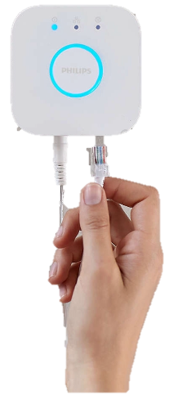
What can I tell you about Philips Hue… He is an light DJ a bit snobbish, but a good guy. If you need a light improvement in your house, you can call him ;)
Philips Hue
Smart devices with sensors
Philips Hue is a line of color changing LED lamps and white bulbs which can be controlled wirelessly.
The Phillips Hue line of bulbs is an smart bulb which can or not have an sensor embedded.
The Philips Hue Bridge is the central controller of the lighting system which allows the smart bulbs to "communicate" with a Smartphone (App).
Hue Bridget

Slide 7
I hope you have learned something new!
Now think in your life where you can find more smart devices or sensors or controllers. I am sure you will find other examples!
See you in task 1.4! ☺
Do not be lazy! You are improving so fast!
You will collect 100 points to finish Task 1.3

